Slide 1

1
Determination of Dynamic Tensile Strength of Concrete Using a Split Hopkinson Pressure Bar
Nik Benko, John Callaway, Nick Dorsett, Martin Raming
ME EN 6960
May 1, 2018
University of Utah
May 1, 2018

Slide 2
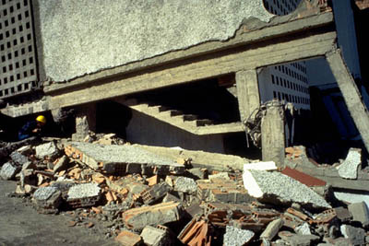
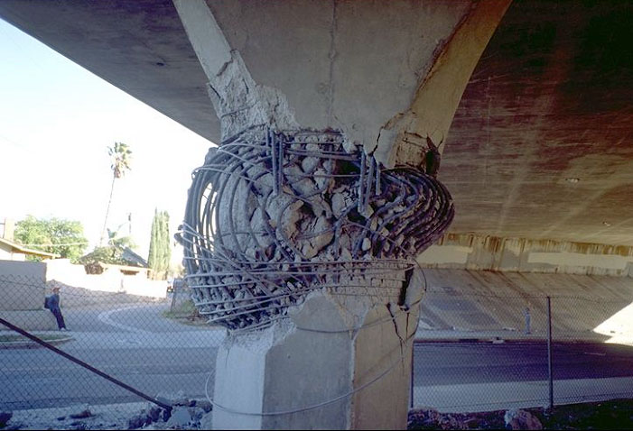
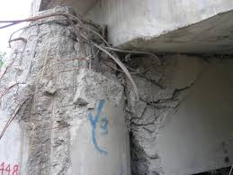
Introduction: Concrete Failure
2
Concrete Failure
Concrete is a common building material – bridges, buildings, roadways, etc.
Concrete is strong in compression and weak in tension.
Failure of concrete structures is often the result of tensile failure.
Failure of concrete is dependent on the loading rate. [1]
Design of structure needs to account for loading rate.
University of Utah
May 1, 2018

Slide 3
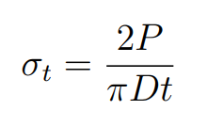
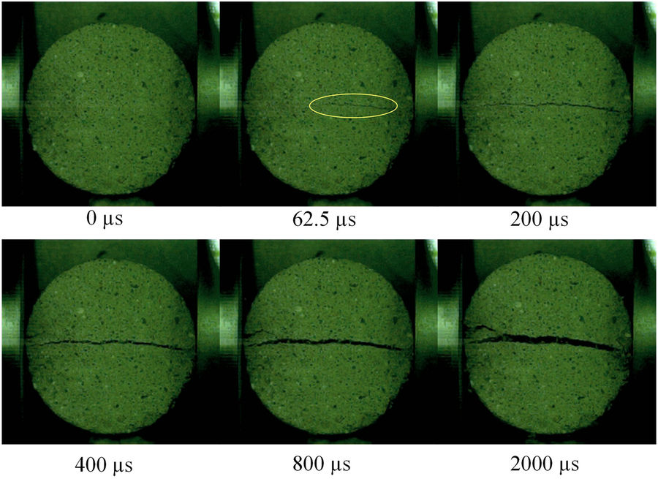
Introduction: Mechanical Testing of Concrete
3
Tensile Testing of Concrete
D
P
P
t = thickness of specimen
Brazil Disc Specimen (ASTM D 3967-08):
Compression creates a tensile failure of the specimen.
Test can be performed quasi-statically or dynamically at high strain rates.
* High speed imagery of concrete Brazil Disc tes from X. Jin et al [1]
University of Utah
May 1, 2018

Slide 4
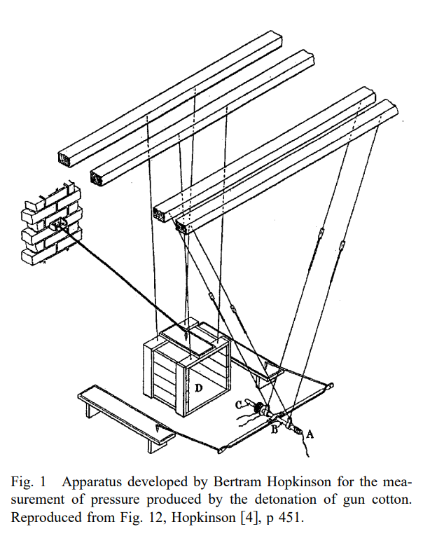
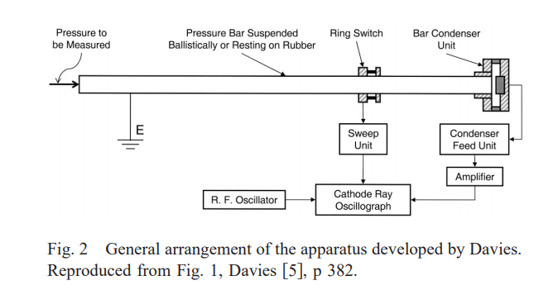
Introduction: Split Hopkinson Pressure Bar
4
Split Hopkinson Pressure Bar (SHPB)
In 1914, Hopkinson introduced a technique for measuring dynamic material strength
Cylindrical steel bar with pellet lightly attached to end
Response of bar determined by measuring momentum of pellet
In 1948, Davies did a critical review of this experimental technique
Microphone and oscillograph used to make photographic record
Dispersion correction equations derived
Kolsky further adapted Davies’ method in 1949 by introducing a second bar on the other end of the specimen with a second microphone at the end
Record made of both incident and transmitted pulses [2]
[3]
[3]
University of Utah
May 1, 2018

Slide 5
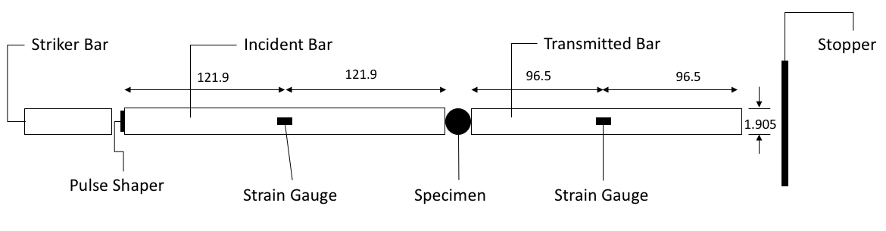
Introduction: Split Hopkinson Pressure Bar
5
Bar Setup
Utilizes thin bars to propagate stress wave into sample
Thin bars simplify motion into one dimension
Bars must be homogenous and have a uniform cross section
The impact from the striker bar must not exceed elastic limit of bars
Strain caused by stress wave is measured at the midpoint of each bar.
Full Wheatsone bridge configuration used to isolate axial strain
Dispersion effects present from finite bars
*not to scale
University of Utah
May 1, 2018

Slide 6
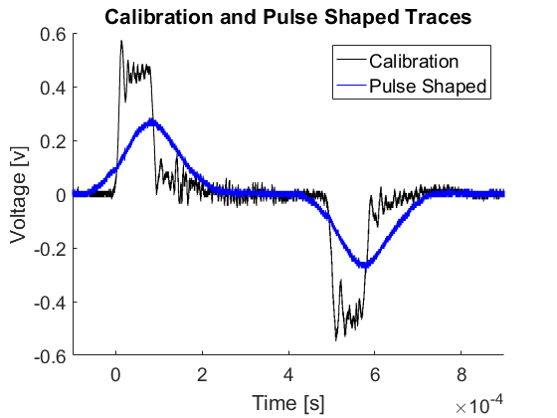
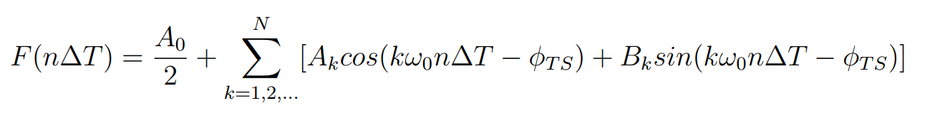
Methods: High Frequency Compensation
6
High Frequency Compensation
Pulse Shaping
Addition of a material between the incident and striker bar – lead, plastic, paper, etc.
Creates a mechanical filter that reduces frequency content of the impulse wave(s).
Pulse shaper material depends on SHPB and specimen materials
Pulse shaped signal should mimic material response of specimen [6]
Dispersion Correction
Utilize non-linear curve fitting and Fourier series to correct for dispersion [7]
[3]
University of Utah
May 1, 2018

Slide 7
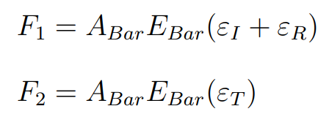
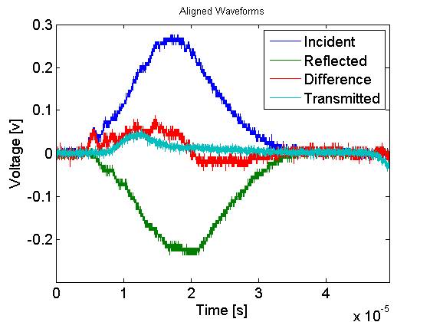
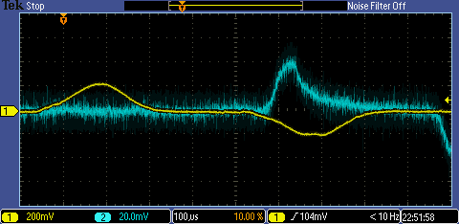
Methods: Wave Position Alignment
7
Wave Position Alignment
Since strain gauges are positioned in the middle of the incident and transmitted bars, waves must be aligned forward/backwards in time.
Utilizing the bar wave speed and known position of strain gauges – waves are aligned in time.
Force equilibrium can then be determined by converting voltages to strain.
Transmitted Wave
Incident Wave
Reflected Wave
University of Utah
May 1, 2018

Slide 8
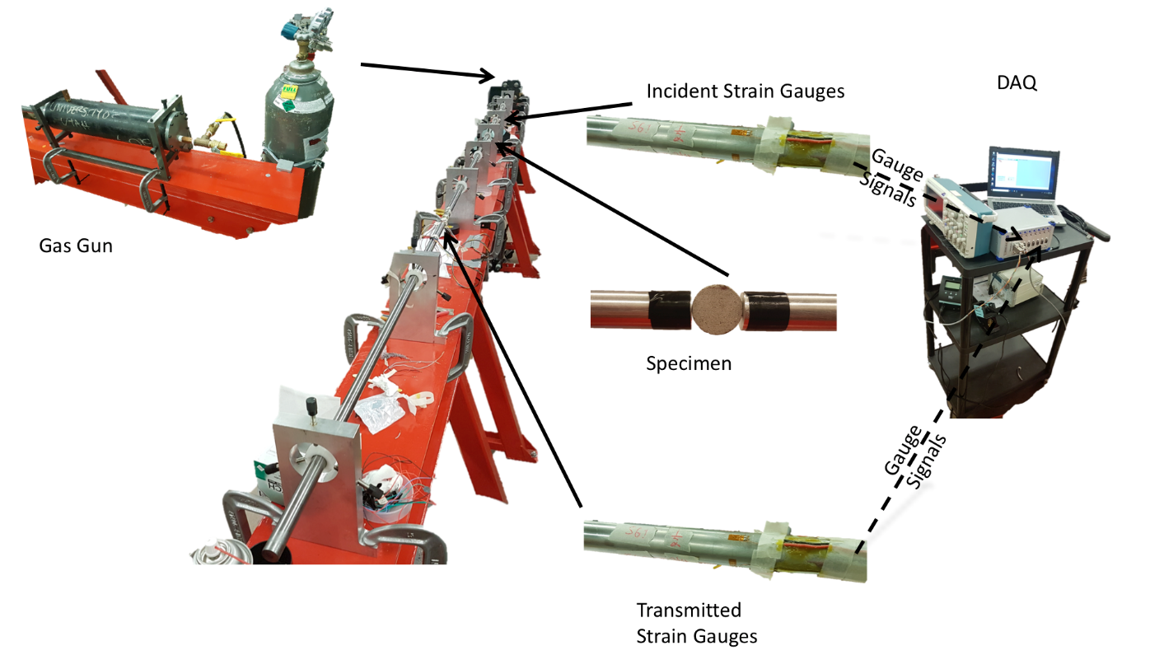
Methods: Test Procedure
8
Test Procedures
Gas gun was utilized to propel striker bar, pressure was varied from 8 to 12.5 psi.
Concrete Brazil Disc specimens were 19.05 mm in diameter and 6.35 mm thick.
SHPB were made of 7075-T6 aluminum.
Lead pulse shaper was 9.525 mm in diameter and 1.058 mm thick.
Sampling was at 125 MHz with a period of 1ms.
University of Utah
May 1, 2018

Slide 9
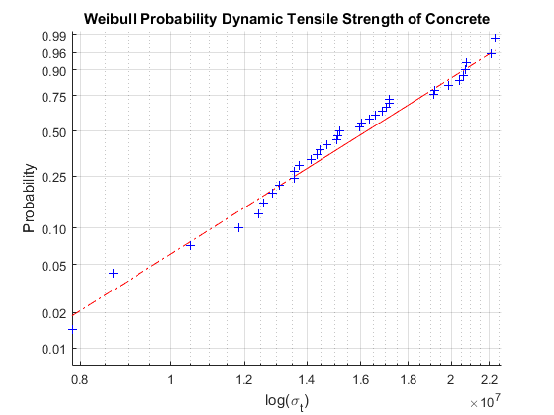
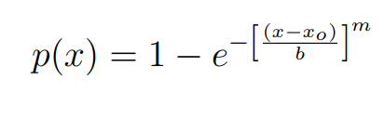
Results: Dynamic Tensile Strength
9
Dynamic Tensile Strength
Dynamic Tensile Strength:
Mean: 15.77 MPa; Median: 15.18 MPa Standard Deviation: 3.60 MPa
Quasi-Static Tensile Strength:
2.2-4.4 MPa [8]
Weibull Analysis [9]:
Where:
x_{o} = 7.84 MPa
b = 17.18 MPa
m = 4.9951
N = 35 specimens
University of Utah
May 1, 2018

Slide 10
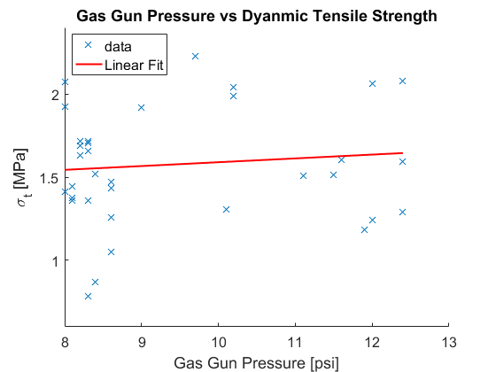
Results: Gas Gun Pressure
10
Gas Gun Pressure and Tensile Strength
Gas Gun Pressure and Strain Rate were expected to be correlated.
No correlation was seen when looking at cumulative class data.
Pulse shaping between groups could impact correlation.
University of Utah
May 1, 2018

Slide 11
Conclusion
11
Conclusions
A positive correlation between strain rate and ultimate tensile strength was confirmed.
Minimal to no correlation between gas gun pressure and strain rate.
Weibull statistical analysis showed moderate variance of strength values.
Further investigation of strain rate using a measured striker bar velocity would allow the relationship between strain rate and tensile strength to be better quantified.
University of Utah
May 1, 2018

Slide 12
Acknowledgements
12
Acknowledgements
Dr. Owen Kingstedt and the High Strain-Rate Mechanics of Materials Laboratory for use of testing equipment and laboratory facilities.
[1] Reference Text Size
University of Utah
May 1, 2018

Slide 13
References
13
References
[1] X. Jin, C. Hou, X. Fan, C. Lu, H. Yang, X. Shu, and Z. Wang, \Quasi-static and dynamic experimental studies on the tensile strength and failure pattern of concrete and mortar discs," in Scientific Reports, 2017.
[2] H. Kolsky, “An investigation of the mechanical properties of materials at very high stain rates of loading,” Proc. Royal Soc., 1949.
[3] B. A. Gama, S. L. Lopatnikov, and J. W. G. Jr., “Hopkinson bar experimental technique: A critical review,” Applied Mechanics, 2004.
[4] Hopkinson B (1914), “A method of measuring the pressure produced in the detonation of high explosives or by the impact of bullets,” Philos. Trans. R. Soc. London, Ser. A 213, 437–456.
[5] Davies RM (1948), “A critical study of the Hopkinson pressure bar,” Philos. Trans. R. Soc. London, Ser. A 240(821), 375–457.
[6] D. Frew, M. J. Forrestal, and W. Chen, “Pulse shaping techniques for testing brittle materials with a split Hopkinson pressure bar," Experimental Mechanics, vol. 42, pp. 93(106), 2002.
[7] P. Follansbee and C. Frantz, “Wave propagation in the split Hopkinson pressure bar," Transactions of the ASME, vol. 105, pp. 93{106}, 1983.
[8] S. U. Pillai and D. Menon, Reinforced Concrete Design, Third Edition.
[9] A. Shukla and J. W. Dally, Experimental Solid Mechanics.
University of Utah
May 1, 2018

